Slide 1


Hack Born Team
1

Slide 2






The way we work
From People
Through Innovation
To Results
2
© 2017 Capgemini. All rights reserved.

Slide 3
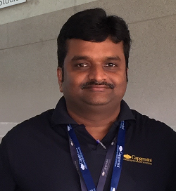
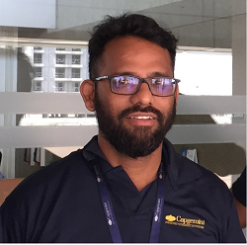
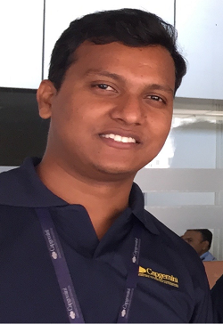
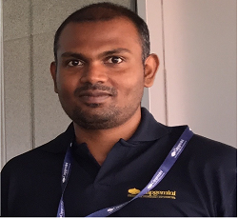
The Team
Arun Ramamurthy
Shahul Shaik
Ashok Banoth
Binny Steevert
Technologies: iOS and Android
Technologies: Frontend, UI
Technologies: Oracle UCM, OWCS
Technologies: iOS and Android
3
© 2017 Capgemini. All rights reserved.

Slide 4
The Problem
Teach an automaton to identify fraudulent transactions, which would help unaccounted wealth to be brought to banking system, mainly by referring to history of transactions
We believe that technology is made
by people, for people
The Solution
Identify specific variables needed for analysis, prepare the data set as our training set
Fit the data to elliptic envelope model, iteratively selecting the correct contamination factor
Create a testing set, with fraudulent transactions
Predict if fraudulent transactions are identified in proposed model
Assumptions
Bank transaction data, with debit and credit across various salary levels, are normally distributed ( Gaussian)
4
© 2017 Capgemini. All rights reserved.

Slide 5
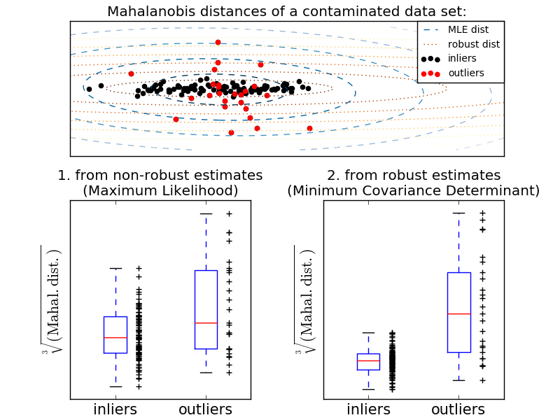
Brief about the solution
Solution to identifying fraudulent transaction is equivalent in statistical analysis to problem of finding outliers in a normally distributed data
Elliptic envelope
Elliptic envelope using Mahalanobis distance to predict is a test point lies in a normal distribution.
Mahalanobis distance, in simple terms, is Euclidean distance of a test point from groups placement(mean), relative to the group’s standard deviation.
5
© 2017 Capgemini. All rights reserved.

Slide 6

Results and next steps
With simulated data, synthesized fraudulent testing data was found to be identified as an inlier.
Causes
Elliptic envelope assumes a normal distribution of data, but the random transactions created would not be fitting to a normal curve
Next Steps – areas of improvement
The solution could be applied on real transactions data, and outliers can be predicted
Graphs can be plotted with the elliptic envelope, using MatLab - MathPlotLib
Optimal contamination factor could be found iteratively
6
© 2017 Capgemini. All rights reserved.

Slide 7
Q&A

